Slide 1
Saint Vincent de Paul Roman Catholic Church
How to Navigate and Use the Bible
Faith Formation:
Youth Ministry
February 16, 2025

Slide 2
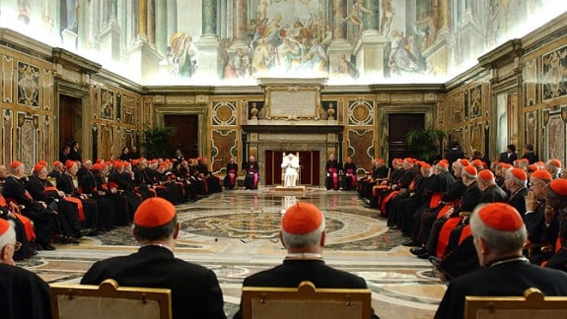
What does the Church Say?
Vatican II
The Church holds teaching authority over Scripture & Tradition open to growth in understanding.
Catechism of the Catholic Church
“Composed by human authors inspired by the Holy Spirit.” 105, 120
“The Church forcefully exhorts all the faithful… to learn the surpassing knowledge of Jesus Christ, by frequently reading of the divine Scripture. ‘Ignorance of the Scriptures is ignorance of Christ.’” (133)
I recommend the New Revised Standard Version (NRSV)

Slide 3
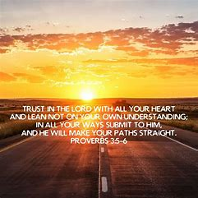
Getting Started
Scripture: God’s salvation plan.
Gospels: Keys to unlock Scripture.
Proverbs: Key Words to live by.
Psalms: Keys to building a relationship with God for better or worse, richer or poorer, in sickness and health, to love and cherish, till death do we join.
The words of Scripture will live in your heart like your favorite song lyrics!

Slide 4
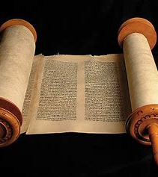
46 Old Testament Books
Historical (21)
Pentateuch (5): Genesis, Exodus, Leviticus, Numbers, Deuteronomy
Joshua, Judges, Ruth, I Samuel, II Samuel, I Kings, II Kings, I Chronicles, II Chronicles, Ezra, Nehemiah, Tobit, Judith, Ester, I Maccabees, II Maccabees
Wisdom (Teach 7): Job, Psalms, Proverbs, Ecclesiastes, Song of Solomon (Canticle of Canticles), Wisdom, Sirach (Ecclesiasticus)
Prophets (Reveal 18): Isaiah, Jeremiah, Lamentations, Baruch, Ezekiel, Daniel, Hosea, Joel, Amos, Obadiah, Jonah, Micah, Nahum, Habakkuk, Zephaniah, Haggai, Zechariah, Malachi

Slide 5
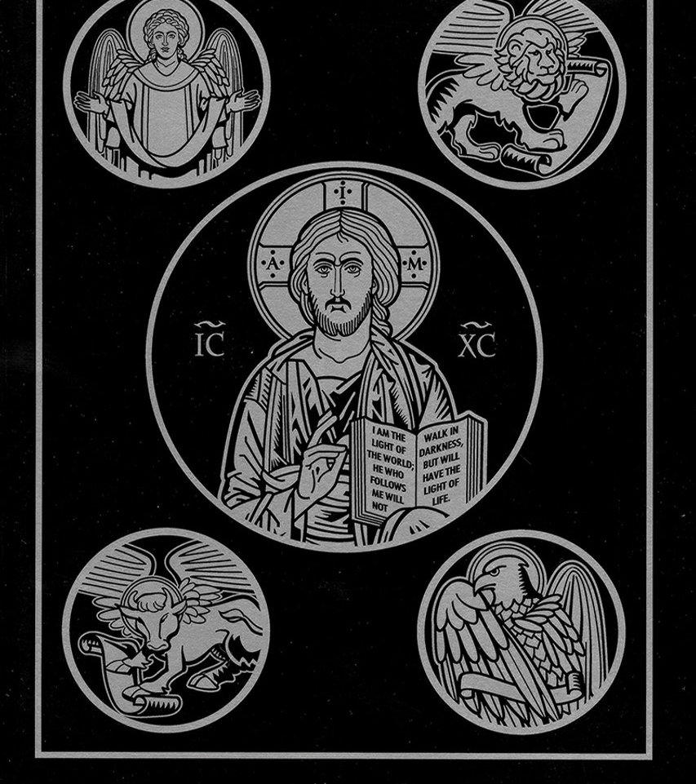
27 New Testament
Historical (5):
Synoptic Gospels (3): Matthew, Mark, Luke
Gospel of John
Acts
Didactic (21 Teach):
Pauline (14): Romans, I Corinthians, II Corinthians, Galatians, Ephesians, Philippians, Colossians, I Thessalonians, II Thessalonians, I Timothy, II Timothy, Titus; Philemon, Hebrews
Catholic (7): James, I Peter, II Peter, I John, II John, III John, Jude
Prophetic: Revelation

Slide 6
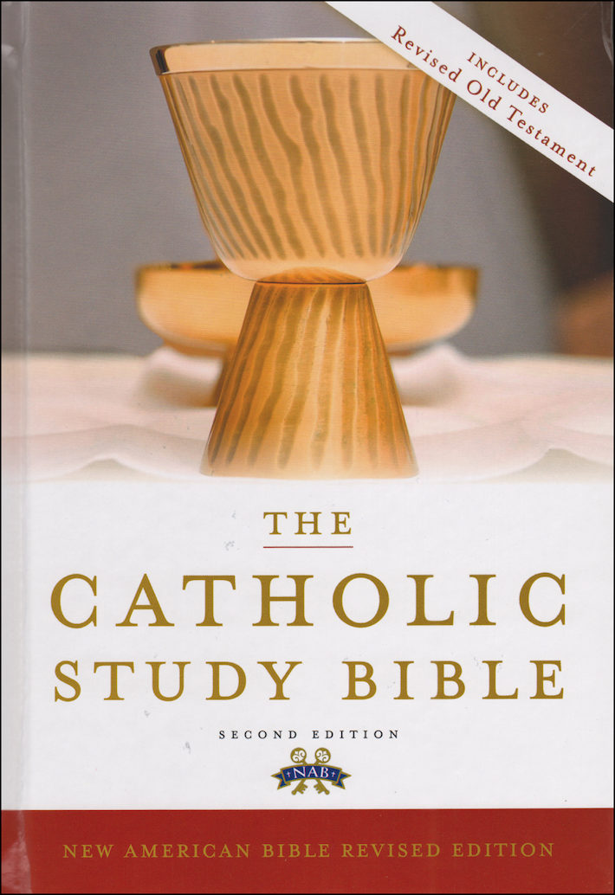
Exploring the Bible
Reading:
Beginning to End (Canonically)
Christ centered (Contextual)
By Date (Chronologically)
By Passage (Liturgy of the Word)
By Topic (Thematic)
Navigation:
Book Tabs, Headings, Chapter & Verse, Concordance (word or phrase search), On-Line Sources
Interpreting:
Catechism, Commentaries, Footnotes, Study Bible
Interpretation Methods:
Historical, Literal, Spiritual (moral, mystery, symbolic)

